Slide 1


Artificial Neural Networks (ANN)
Hossam Ahmed Salah
MSP Helwan

Slide 2



Agenda
Perceptron
Layers
Activation functions
Loss function
Forward propagation
Back propagation
Optimization

Slide 3









Perceptron
$${ x}_{1}$$
$$w_{1}$$
$$Σ$$
$$f\left(z\right)$$
$${ x}_{2}$$
$$w_{2}$$
$$\hat{y}$$
Features (input)
$$w_{3}$$
$${ x}_{3}$$

Slide 4
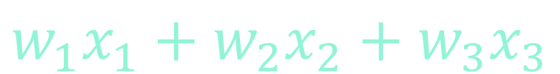
Perceptron
$${ x}_{1}$$
$$w_{1}$$
$$Σ$$
$${ x}_{2}$$
$$w_{2}$$
$$w_{1}x_{1}+w_{2}x_{2}+w_{3}x_{3}$$
$$w_{3}$$
$${ x}_{3}$$

Slide 5

Perceptron
$${ x}_{1}$$
$$w_{1}$$
$$\sum{w_{i}x_{\dot{i}}}$$
$$Σ$$
$${ x}_{2}$$
$$w_{2}$$
$$w_{3}$$
$${ x}_{3}$$

Slide 6

Perceptron
Bias + $\sum{w_{i}x_{\dot{i}}}$
Why using Bias ?
allows the network to learn more complex functions and improve its ability to generalize to new data.
Considering some factors that is not in the input and may cause error.
It’s as why we used bias in linear regression it adds more moving over y axis that provide better options for fitting the data
Until now this image represent a linear regression a linearity .
$${ x}_{1}$$
$$w_{1}$$
$$Σ$$
$${ x}_{2}$$
$$w_{2}$$
$$w_{3}$$
1
$${ x}_{3}$$
Bias

Slide 7








Perceptron
$${ x}_{1}$$
We need to get rid of the linearity !
Linear Models not useful in Classification unless it mapped to probabilities using a function like Logistic function
So, we choose a logistic function to be F(Z)
$$w_{1}$$
$$Σ$$
$$f\left(z\right)$$
$${ x}_{2}$$
$$w_{2}$$
$$w_{3}$$
$${ x}_{3}$$
1
Bias

Slide 8
Perceptron
$${ x}_{1}$$
We need to get rid of the linearity !
Linear Models not useful in Classification unless it mapped to probabilities using a function like Logistic function
So, we choose a logistic function to be F(Z)
This is called Activation function
$$w_{1}$$
$$Σ$$
$$f\left(z\right)$$
$${ x}_{2}$$
$$w_{2}$$
$$w_{3}$$
$${ x}_{3}$$
1
Bias

Slide 9

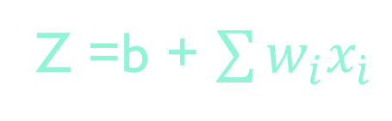

Perceptron
We created a Classification Perceptron equivalent to Logistic Regression
$${ x}_{1}$$
$$w_{1}$$
Z =b + $\sum{w_{i}x_{\dot{i}}}$
$$σ\left(b+\sum{w_{i}x_{i}}\right)$$
$$Σ$$
$$σ\left(z\right)$$
$${ x}_{2}$$
$$w_{2}$$
$$w_{3}$$
$${ x}_{3}$$
1
Bias

Slide 10






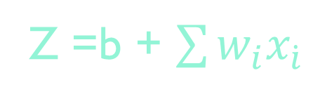




Perceptron
$${ x}_{1}$$
$$w_{1}$$
Z =b + $\sum{w_{i}x_{\dot{i}}}$
$$Σ$$
$$σ\left(z\right)$$
$${ x}_{2}$$
$$w_{2}$$
$$\hat{y}$$
$$w_{3}$$
$$σ\left(b+\sum{w_{i}x_{i}}\right)$$
$${ x}_{3}$$
1
Bias

Slide 11
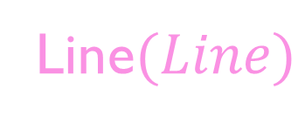


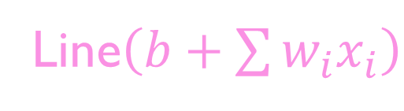
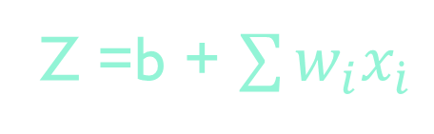


Why Nonlinear Activation Function?
Z =b + $\sum{w_{i}x_{\dot{i}}}$
$$Σ$$
l$\left(z\right)$
$$\hat{y}$$
$$x^{T}w+b$$
Line$\left(b+\sum{w_{i}x_{i}}\right)$
Line$(Line)$
Another Line in different dimensions

Slide 12
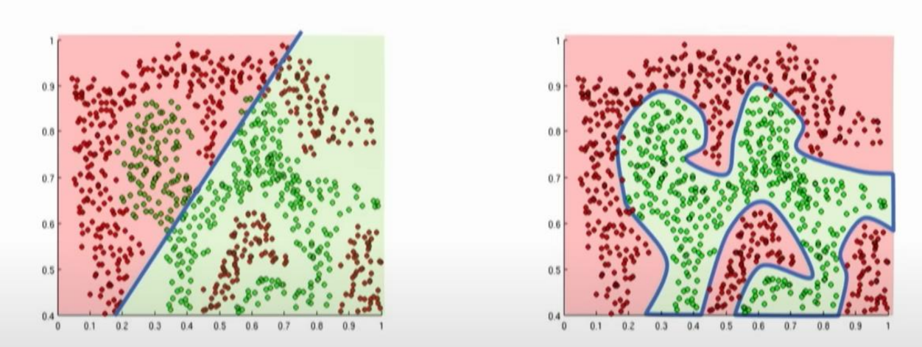
Why Nonlinear Activation Function?

Slide 13








Perceptron building block
$${ x}_{1}$$
$$w_{1}$$
$$Σ$$
$$f\left(z\right)$$
$${ x}_{2}$$
$$w_{2}$$
$$w_{3}$$
$${ x}_{3}$$
1
Bias

Slide 14



Perceptron building block
$${ x}_{1}$$
$$w_{1}$$
$$Z$$
$$Y=f\left(z\right)$$
$${ x}_{2}$$
$$w_{2}$$
$$w_{3}$$
$${ x}_{3}$$
$$w_{0}=b$$
Bias
1

Slide 15











Perceptron building block
$${ x}_{1}$$
$$w_{1}$$
$$Z_{1}$$
$$y_{1}=f\left(z_{1}\right)$$
$$w_{2}$$
$${ x}_{2}$$
$$w_{3}$$
$${ x}_{3}$$
$$Z_{2}$$
$$y_{2}=f\left(z_{2}\right)$$
$$w_{0}$$
Bias
1

Slide 16


Simple NN
$${ x}_{1}$$
$$w_{1}$$
$$Z_{1}$$
$$y_{1}=f\left(z_{1}\right)$$
$$w_{2}$$
$$f\left(z\right)$$
$${ x}_{2}$$
$$\hat{y}$$
$$w_{3}$$
$${ x}_{3}$$
$$Z_{2}$$
$$y_{2}=f\left(z_{2}\right)$$
$$w_{0}$$
Bias
1

Slide 17
Simple NN
$${ x}_{1}$$
$$w_{1}$$
$$Z_{1}$$
$$y_{1}=f\left(z_{1}\right)$$
$$w_{2}$$
$$f\left(z\right)$$
$${ x}_{2}$$
$$\hat{y}$$
$$w_{3}$$
$${ x}_{3}$$
$$Z_{2}$$
$$y_{2}=f\left(z_{2}\right)$$
Output Layer
$$w_{0}$$
Bias
1
Hidden Layer(s)
Input Layer

Slide 18
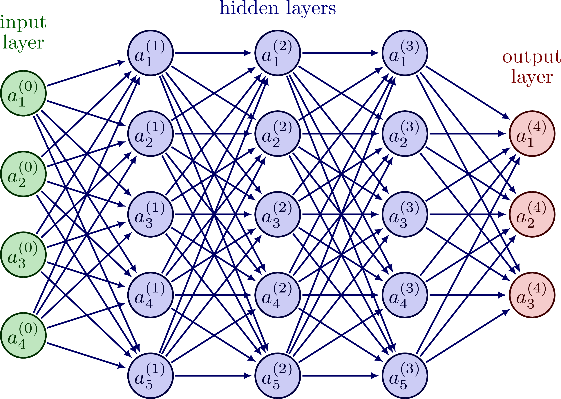

Slide 19

Activation functions

Slide 20
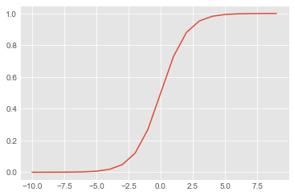
Logistic
def Logistic(x):
return 1/(1+np.e**(-x))
inputs = [x for x in range(-10,10)]
outputs = [Logistic(x) for x in inputs]
plt.plot(inputs, outputs)
# range from 0 ot 1

Slide 21
Logistic
Pros
Cons
When to use it?
The output layer in binary classification
Don’t use it in the hidden layers as activation function
It produces outputs in the range of 0 to 1, which can be interpreted as probabilities.
Good for binary classification
It suffers from the vanishing gradient problem, which can slow down the learning process

Slide 22
Softmax
def softmax(x):
return np.exp(x)/np.exp(x).sum()
inputs = [0.1, 0.2, 0.3]
outputs = softmax(inputs)
print(outputs)
print(outputs.sum())
[0.30060961 0.33222499 0.3671654 ] 1.0000000000000002

Slide 23
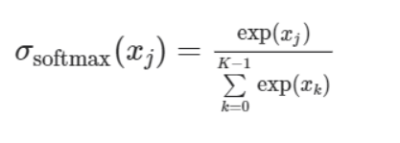

Softmax
Pros
Cons
When to use it?
The output layer in multi-class classification
Don’t use it in the hidden layers as activation function
It can be used for multi-class classification problems.
It produces outputs in the range of 0 to 1, which can be interpreted as probabilities that sum up to 1.
Generalization of logistic with classes = 2
It suffers from the vanishing gradient problem, which can slow down the learning process
Derivatives can go to very small numbers almost zero confusing the GD and make it slow the Learning rate

Slide 24
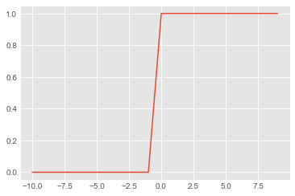
Binary Step
def bin_step(x):
if x < 0:
return 0
else:
return 1
inputs = [x for x in range(-10,10)]
outputs = [bin_step(x) for x in inputs]
plt.plot(inputs, outputs)
plt.show()

Slide 25
Binary step
Cons
It is not differentiable at the point where the output switches from 0 to 1, which can make it difficult to use in gradient-based optimization algorithms.
It does not provide information about the magnitude of the input, which can limit its usefulness in some applications.
It can suffer from the vanishing gradient problem, which occurs when the gradients become very small or zero, making it difficult to update the weights during training
Pros
When to use it?
Don’t
It is computationally efficient and easy to implement.
It is computationally efficient and easy to implement.
It can be useful for thresholding the output of a neuron to produce binary outputs.

Slide 26
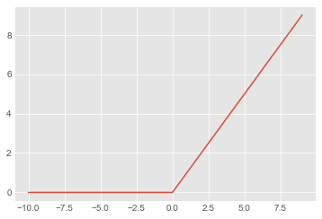
ReLU
def rectified(x):
return max(0.0, x)
inputs = [x for x in range(-10,10)]
outputs = [rectified(x) for x in inputs]
plt.plot(inputs, outputs)
plt.show()

Slide 27
ReLU
Cons
Not always differentiable: ReLU is not differentiable at zero, which can cause problems during backpropagation. (solved with leaky)
ReLU can result in "dead" neurons, where the neuron always outputs zero, which can happen if the neuron's weights are set such that the input is always negative
ReLU has an output range of [0, ∞), which may not be suitable for all types of problems.
Pros
When to use it?
Hidden Layers
Commonly used
Default in most cases
It is computationally efficient and easy to implement.
ReLU can induce sparsity in neural networks by setting negative values to zero, which can help reduce overfitting.
Avoids vanishing gradient problem

Slide 28
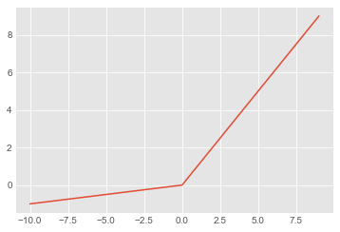
Leaky ReLU
def rectified_mod(x, w=0.1):
return max(w*x, x)
inputs = [x for x in range(-10,10)]
outputs = [rectified_mod(x) for x in inputs]
plt.plot(inputs, outputs)
plt.show()

Slide 29
Leaky ReLU
Cons
Not always differentiable: Like ReLU, Leaky ReLU is not differentiable at zero, which can cause problems during backpropagation. However, this issue can be addressed by using a smoothed version of Leaky ReLU such as the exponential linear unit (ELU)
Pros
When to use it?
Not commonly used although
Avoids dead neurons
Computationally efficient
Allows a small, non-zero gradient when the input is negative, instead of setting the output to zero as ReLU does.

Slide 30
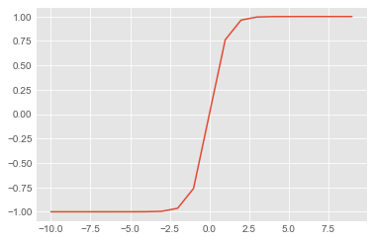
Tanh
def tanh(x):
return(np.exp(x)-np.exp(-x))/(np.exp(x)+np.exp(-x))
inputs = [x for x in range(-10,10)]
outputs = [tanh(x) for x in inputs]
plt.plot(inputs, outputs)
# e^x = np.exp(x) = np.e**x
# tanh range from -1 to 1

Slide 31
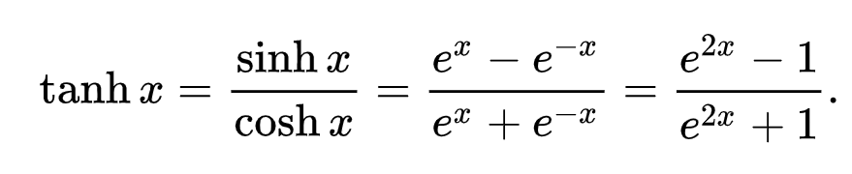
Tanh
hyperbolic tangent
Pros
Cons
When to use it?
Instead of logistic in the hidden layers more ranges from -1 to 1 and centered about he zero not 0.5
Tanh is a symmetric function that maps the input to the range (-1, 1). This can be useful in some cases where the output needs to be symmetric around zero.
Smooth gradient: The gradient of the tanh function is smooth and continuous
It suffers from the vanishing gradient problem.
Computationally expensive
Saturation: Tanh can become saturated when the input values are very large or very small, which can cause the gradients to become very small. This can make it difficult to train deep neural networks with many layers.

Slide 32
Tanh
hyperbolic tangent
Saturation: Tanh can become saturated when the input values are very large or very small, which can cause the gradients to become very small. This can make it difficult to train deep neural networks with many layers.
saturation refers to a situation where the output of an activation function becomes "stuck" at a certain value due to the input being very large or very small. When the output of an activation function is saturated, the derivative (or gradient) of the function becomes very small, which can make it difficult to train the network.
weight initialization and batch normalization can be used to help prevent saturation and improve the performance of deep neural networks
batch normalization :It is a form of normalization that is applied to the activations of the hidden layers of the network.

Slide 33
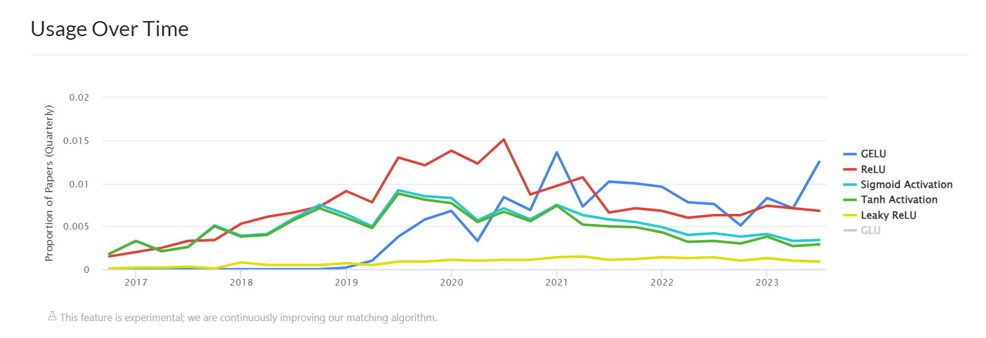

Slide 34


Example
Will you pass an Exam ?
Factor 1 $x_{1}$ is Number of lectures you attend
Factor 2 $x_{2}$ is Number of hours you studied

Slide 35
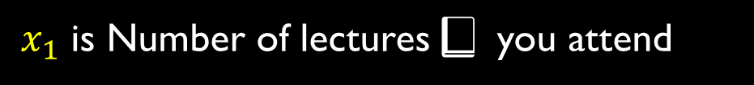


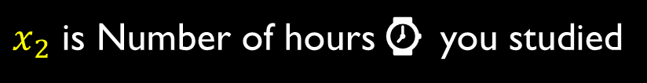
Example
Will you pass an Exam ?
$x_{1}$ is Number of lectures📕 you attend
$$x_{2}$$
$x_{2}$ is Number of hours⌚ you studied
✅
✅
✅
✅
✅
✅
✅
✅
❌
❌
❌
$$x_{1}$$

Slide 36

Example
Will you pass an Exam ?
$x_{1}$ is Number of lectures📕 you attend
$$x_{2}$$
$x_{2}$ is Number of hours⌚ you studied
✅
✅
✅
⁉️
✅
$$\left[\begin{matrix}4 \\ 5\end{matrix}\right]$$
✅
✅
✅
✅
❌
❌
❌
$$x_{1}$$

Slide 37







$$Z_{1}$$
$${ x}_{1}$$
$$f\left(z\right)$$
$$Z_{2}$$
$$\hat{y}$$
$${ x}_{2}$$
$$Z_{3}$$

Slide 38



Loss
$$Z_{1}$$
Predicted 0.1
$${ x}_{1}$$
$$f\left(z\right)$$
$$Z_{2}$$
$$\hat{y}$$
$$\left[4,5\right]$$
Actual 1
$${ x}_{2}$$
$$Z_{3}$$
$$x^{\left(ⅈ\right)}$$
$$l\left(f\left(x^{\left(ⅈ\right)};w\right),y^{\left(ⅈ\right)}\right)$$

Slide 39
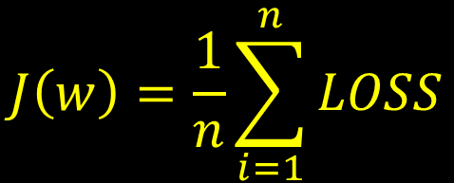
Cost :overall loss in the entire dataset
$$J\left(w\right)=\frac{1}{n}\sum_{i=1}^{n}{LOSS}$$
$$Z_{1}$$
$${ x}_{1}$$
$$f\left(z\right)$$
$$Z_{2}$$
$$\hat{y}$$
$${ x}_{2}$$
$$Z_{3}$$
$$l\left(f\left(x^{\left(ⅈ\right)};w\right),y^{\left(ⅈ\right)}\right)$$

Slide 40
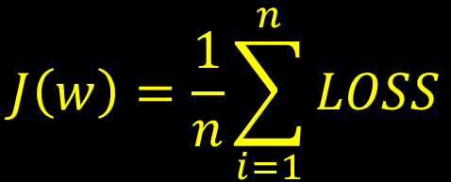

Cost :overall loss in the entire dataset
$$l\left(f\left(x^{\left(ⅈ\right)};w\right),y^{\left(ⅈ\right)}\right)$$
As usual out target is to minimize the error(cost) by finding best estimate of the parameters
$$J\left(w\right)=\frac{1}{n}\sum_{i=1}^{n}{LOSS}$$

Slide 41
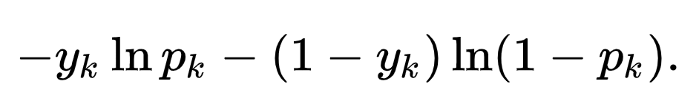
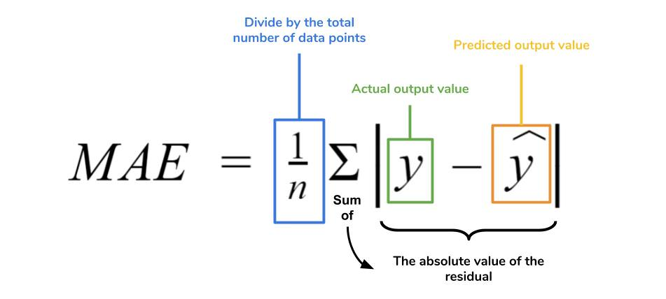
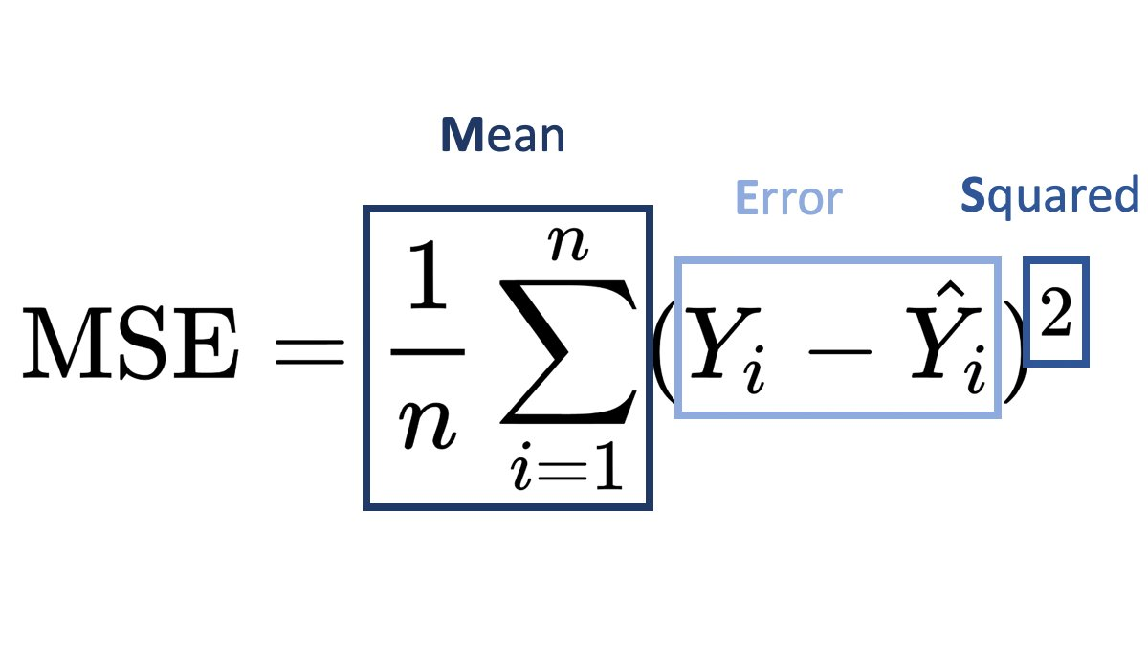
Loss functions
Loss functions for classification
Log loss (cross entropy)
Loss function for Regression
MSE
MAE
RSS

Slide 42
Forward propagation
Forward propagation starts with an input vector, which is passed to the first layer of the neural network.
Each neuron in the first layer receives the input vector and calculates a weighted sum of the inputs, adding a bias term to the sum.
The weighted sum is then passed through an activation function, which introduces nonlinearity into the output of the neuron.
The output of each neuron in the first layer becomes the input to the next layer in the network.
The process of calculating the weighted sum and passing it through an activation function is repeated for each layer in the network until the final layer is reached.
The output of the final layer is the predicted output of the neural network for the given input.
During the forward propagation process, the weights and biases of the network are fixed, and no updates are made to them.
The output of the network can be compared to the true output to calculate a loss function, which measures the error between the predicted output and the true output.
The loss function is used during the backpropagation process to update the weights and biases of the network and improve its performance

Slide 43
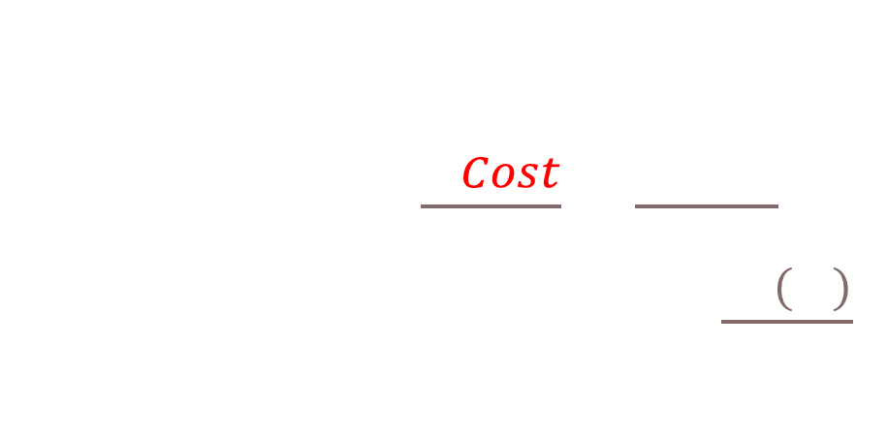
GD and backpropagation
GD
Initialize weights randomly
LOOP until convergence
Compute gradient $\frac{∂ Cost}{∂w}$ = $\frac{∂ J(w)}{∂w}$
Update weights $w⇐w−η\frac{∂J\left(w\right)}{∂w}$
Return weights

Slide 44





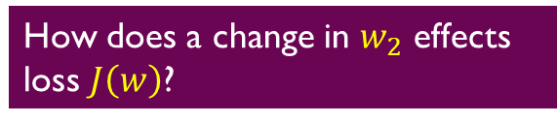
GD and backpropagation
$${ x}_{1}$$
$$w_{1}$$
$$Z_{1}$$
$$w_{2}$$
$$f\left(z\right)$$
$$\hat{y}$$
$$J\left(w\right)$$
How does a change in $w_{2}$ effects loss $J\left(w\right)$?

Slide 45


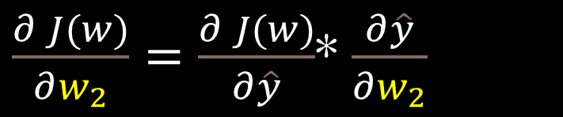

GD and backpropagation
$${ x}_{1}$$
$$w_{1}$$
$$Z_{1}$$
$$w_{2}$$
$$f\left(z\right)$$
$$\hat{y}$$
$$J\left(w\right)$$
How does a change in $w_{2}$ effects loss $J\left(w\right)$?
$J\left(w\right)$ is a function in terms of $\hat{y}$
$\frac{∂ J(w)}{∂w_{2}}=\frac{∂ J(w)}{∂\hat{y}}$* $\frac{∂\hat{y}}{∂w_{2}}$
$\hat{y}$ is a function in terms of $w_{2}$

Slide 46

GD and backpropagation
$${ x}_{1}$$
$$w_{1}$$
$$Z_{1}$$
$$w_{2}$$
$$f\left(z\right)$$
$$\hat{y}$$
$$J\left(w\right)$$
How does a change in $w_{2}$ effects loss $J\left(w\right)$?
$J\left(w\right)$ is a function in terms of $\hat{y}$
$\frac{∂ J(w)}{∂w_{2}}=\frac{∂ J(w)}{∂\hat{y}}$* $\frac{∂\hat{y}}{∂w_{2}}$
$\hat{y}$ is a function in terms of $w_{2}$
$z_{1}$is a function in terms of $w_{1}$

Slide 47
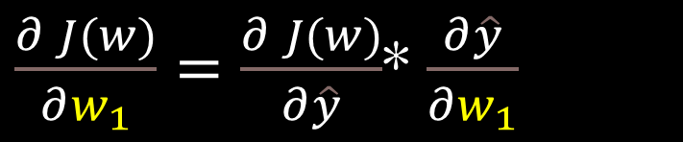

GD and backpropagation
$${ x}_{1}$$
$$w_{1}$$
$$Z_{1}$$
$$w_{2}$$
$$f\left(z\right)$$
$$\hat{y}$$
$$J\left(w\right)$$
How does a change in $w_{1}$ effects loss $J\left(w\right)$?
$J\left(w\right)$ is a function in terms of $\hat{y}$
$\frac{∂ J(w)}{∂w_{1}}=\frac{∂ J(w)}{∂\hat{y}}$* $\frac{∂\hat{y}}{∂w_{1}}$
$\hat{y}$ is a function in terms of $w_{2}$
$z_{1}$is a function in terms of $w_{1}$

Slide 48
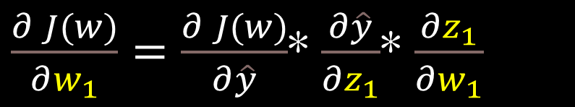
GD and backpropagation
$${ x}_{1}$$
$$w_{1}$$
$$Z_{1}$$
$$w_{2}$$
$$f\left(z\right)$$
$$\hat{y}$$
$$J\left(w\right)$$
How does a change in $w_{1}$ effects loss $J\left(w\right)$?
$J\left(w\right)$ is a function in terms of $\hat{y}$
$\frac{∂ J(w)}{∂w_{1}}=\frac{∂ J(w)}{∂\hat{y}}$* $\frac{∂\hat{y}}{∂z_{1}}$* $\frac{∂z_{1}}{∂w_{1}}$
$\hat{y}$ is a function in terms of $w_{2}$
$z_{1}$is a function in terms of $w_{1}$

Slide 49
Optimization
The idea is not to make the learning rate fixed
This is called Adaptive Learning Rates
Examples
SGD
Adam 🌟 use this
Adadelta
Adagrad
RMSProp
We would use this to demo how GD works

Slide 50

See 👀
https://playground.tensorflow.org/
https://datascience.stackexchange.com/questions/12851/how-do-you-visualize-neural-network-architectures
https://mathworld.wolfram.com/HyperbolicTangent.html
https://github.com/lilipads/gradient_descent_viz🌟
https://blog.paperspace.com/intro-to-optimization-in-deep-learning-gradient-descent/

Slide 51
References
https://paperswithcode.com/method/gelu the graph of activation function usage over time
https://en.wikipedia.org/wiki/Hyperbolic_functions
https://arxiv.org/pdf/1502.03167.pdf
http://introtodeeplearning.com/

Slide 52

Thank You

